Slide 1
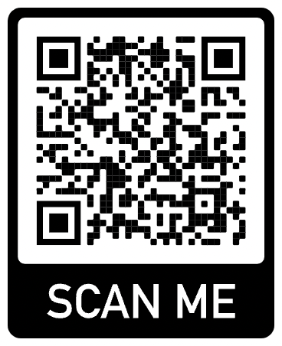
Induction Pack
2025
Purpose. Passion. Belong.
#RedbacksLeadStrong
Author & Copyright 2025 Mordialloc Redbacks Junior Football Club – Committee
‹#›

Slide 2
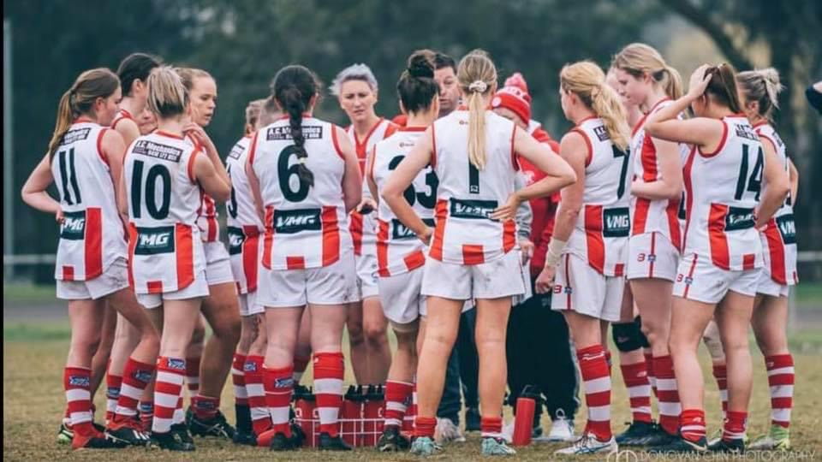
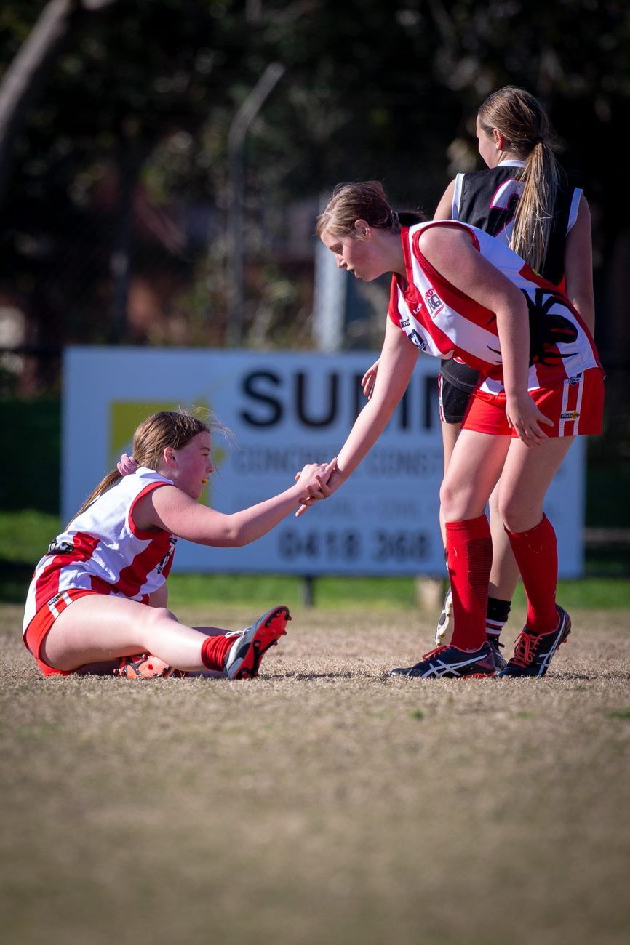
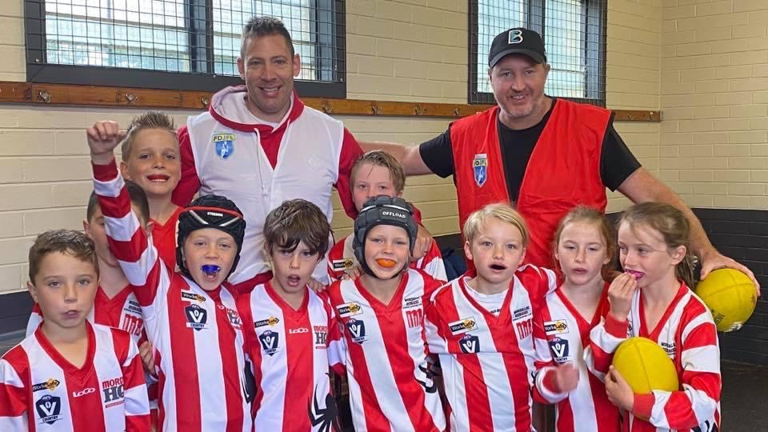
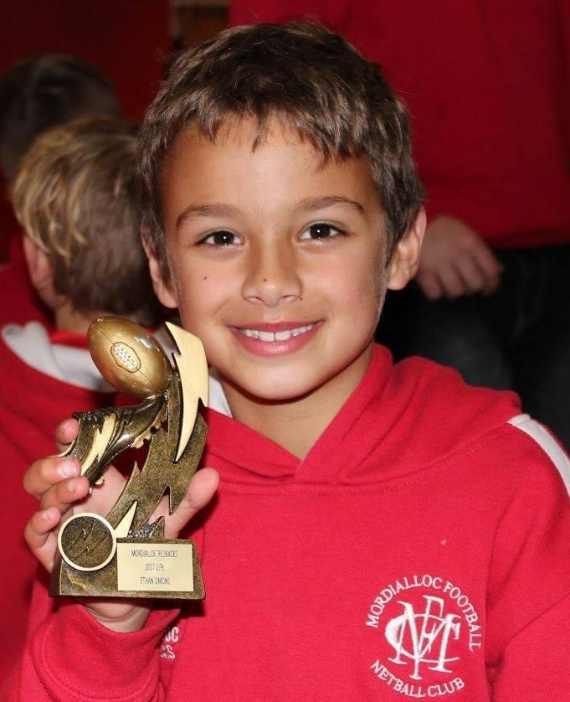
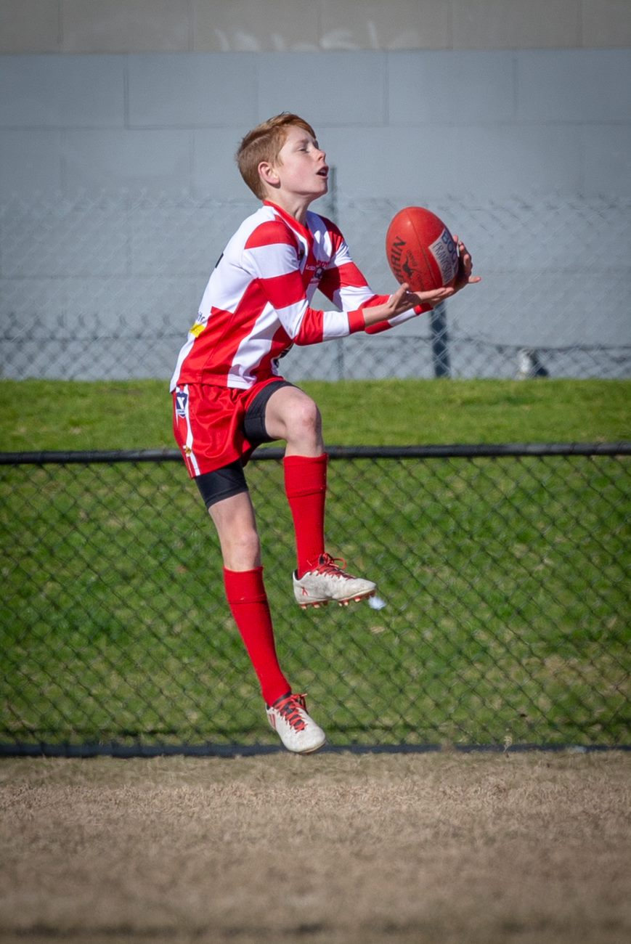
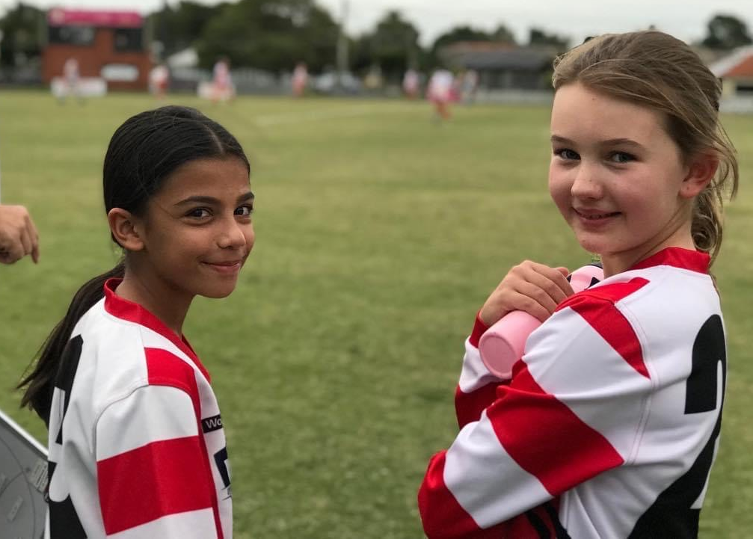
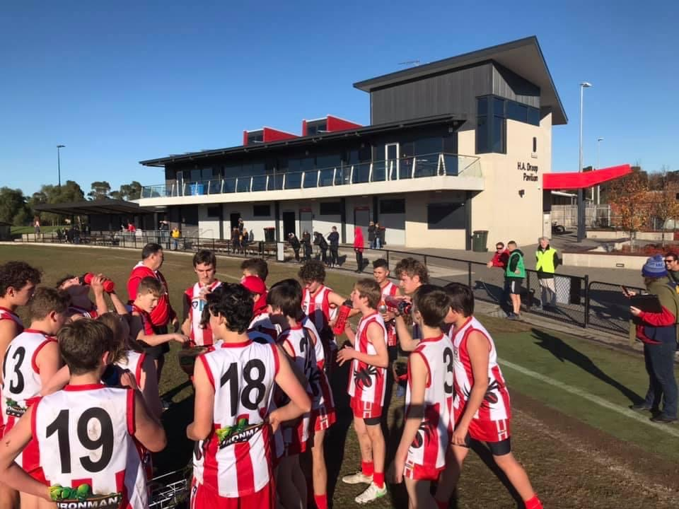
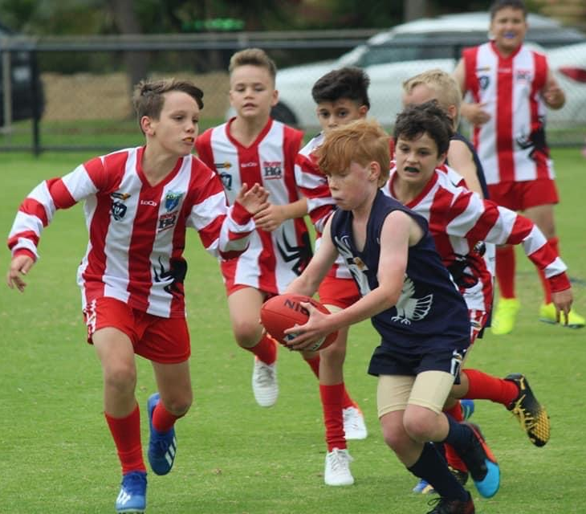
‹#›

Slide 3
CONTENTS
1. About Us
2. Welcome & FAQs
3. Policies
4. Club Committee
5. Game Day
6. Contact Us
‹#›

Slide 4
ABOUT US
Who We Are
Our History
Our Values
Our Mission & Vision
Our Song
‹#›

Slide 5
a. Who We Are
Established in 2014, the Mordialloc Redbacks Junior Football Club is a vibrant, family-friendly sporting community.
We proudly offer junior football programs including Auskick and junior teams, fostering a fun, inclusive environment where kids of all abilities can develop their skills, make friends, and enjoy Aussie Rules football.
We share our facilities with the Mordialloc Football Netball Club at Ben Kavanagh Reserve, located on the corner of Chute and McDonald Streets. We are in the AFL’s South-East region, and belong to the Frankston & District Junior Football League and South East Regional League. We thrive on being a smaller club, ensuring more playing time for our kids and creating a delightful, family-friendly atmosphere for all to enjoy community sports and social events. 🏉🏐🏏
‹#›

Slide 6
b. Our History
Some of our short (but passionate and progressive) history!
​
*2013*: Jan Mildenhall assumes the role of Secretary at the Mordialloc Sporting Club and, along with former Secretary Jacqui Millar, begins gauging interest in establishing a new junior football team in the area, located between Edithvale-Aspendale and Mordi-Brae Junior Football Clubs. Flyers are produced with the support of seven local schools to promote the vision for the new club.
*2014* The Mordialloc Redbacks Junior Football Club is officially established with 19 players for its inaugural season.
*2018* The club runs its season out of shipping containers while awaiting approval for the construction of a new pavilion.
*2019* The new state-of-the-art H.A. Droop pavilion at Ben Kavanagh Reserve is handed over to the club.
*2023* The Mordy Redbacks Junior Football Club has grown to over 100 junior football players. Impressively, half of our teams have advanced to the league's finals, and we've received nominations for seven league awards. Additionally, four of our players have trialled for inter-league positions, and we proudly note that our first two players who have risen through the juniors program have entered the senior competition 🏆🌟
Acknowledgments: Special thanks to Danny Forbes, Steve Jeffreys, Terry Evans, Simon Payne, Brendan Swifte, and Ally McCormick, who played integral roles in the club's presidency, secretary and supporting positions during its beginnings. Gratitude is extended to the current President, Keeghan Williams, and the dedicated committee members for their leadership and commitment to the club's values: Purpose, Passion, and Belonging.
‹#›

Slide 7
c. Our Values
At our core:
We wholeheartedly promote enjoyment and inclusion for all junior footballers, ensuring an environment free from discrimination, vilification, intolerance, and bullying.
We are committed to:
Utilising our platform and influence for the betterment of our community.
Nurturing the growth of our members in football, healthy living, and life skills.
Holding everyone involved, including players, administration, and supporters, to high standards of encouragement, respect, and adherence to competition rules.
‹#›

Slide 8
d. Our Mission & Aim
Mordialloc Junior Football Club is defined by its core values: Purpose, Passion, and Belong. 🚀🔥🤝 #RedbacksLeadStrong
Our commitment is to create an environment that is not only meaningful and inclusive but also fosters positivity and caters to a wide range of skill levels, from beginners to advanced. We encourage you to use our hashtag #RedbacksLeadStrong on various social media platforms to share instances where these values shine through.
Our Mission:
We're on a mission to provide children, regardless of their capabilities and backgrounds, with the opportunity to enjoy Australian Rules Football and gain valuable life skills. Our goal is to nurture the leaders of tomorrow within our community. 🌟🏈👦👧
Our Aim:
• To excel in our local leagues, where success goes beyond sporting ability and encompasses participation and inclusion.
• To empower our players with essential life skills like respect, discipline, commitment, teamwork, and leadership.
• To actively engage in our community, creating a sense of belonging for everyone. 🤗🤝🏆
‹#›

Slide 9
e. Our Song
“It’s a grand old flag
It’s a high flying flag
It’s the emblem for me and for you
It’s the emblem of the team we love
The team of the red and the white
Every heart beats right
For the red and the white
And we sing this song for you
Should auld acquaintance be forgot
Keep your eye on the red and the white!”
https://www.youtube.com/watch?v=1oh-uWMgTm0
‹#›

Slide 10
2. WELCOME & FAQS
Staying up to date
Registrations
Uniforms & Merchandise
Playing Equipment
Induction Pack
Volunteering
Dental Mouthguards
Training & Season Dates
Age groups
Our teams
Game dates/locations
Events calendar
- Fixtures
- Lightning Premiership
- Jumper & Medal Presentation
- Club Social Functions
‹#›

Slide 11
FAQs
Stay informed with the latest updates from Mordialloc Redbacks JFC through two convenient options:
Team App
- Download the free Team App from the App Store or Google Play.
- Sign up and activate your account through the email sent to you.
- Log in and search for "Mordialloc Redbacks JFC," then request membership.
Please note that all future club communications will be conducted through Team App as the main communication. Stay connected and up-to-date with the Redbacks! 📱📧🏈
‹#›

Slide 12
Stay even more connected with us through our social media channels:
Facebook - [https://www.facebook.com/mordyredbacks/](https://www.facebook.com/mordyredbacks/)
Instagram - [https://www.instagram.com/mordyredbacksjfc/](https://www.instagram.com/mordyredbacksjfc/)
Registrations:
A huge thank you to all families who have already registered for 2025. For those who haven't, please visit www.mordyredbacksjfc.com.au and follow the registration link on the homepage. Feel free to share these details with prospective players and families who may be interested.
Uniforms & Merchandise:
All players will receive a playing guernsey, and new registrants will get a bag and a pair of socks. Shorts and any replacement items can be purchased through our merchandise team. More information on purchasing additional merchandise will be available on Team App before the season begins.
Milestone Banners:
You can track your child's game stats through PlayHQ, including the number of games played. Many clubs encourage families to organise milestone banners for their child's special day. Here are some ideas: www.addsignage.com.au/milestone-banners and www.milestonebanners.com.au
‹#›

Slide 13
Playing Equipment:
Players must have their own football boots and wear mouthguards during games and contact drills. Team managers will assist with uniform organization.
Induction Pack:
The club provides an induction pack to help families understand the season, club structure, volunteer roles, and game-day responsibilities. It's available online at www.mordyredbacksjfc.com.au/induction-pack
Volunteering:
This great club relies on volunteers. We’d love your help. Contact the coach, team manager, or use the provided email address. The club welcomes volunteers and encourages involvement.
Contact Information:
For registration and questions, the club committee is ready to assist. Reach out without hesitation for a smooth experience.
‹#›

Slide 14
Dental Mouthguards:
We've partnered with The Local Dental Group to offer custom-fit sports mouthguards at reduced rates. They'll take impressions at their clinic, and your mouthguards will be ready in one to two weeks.
For more information on the importance of mouthguards, check out the Australian Dental Association's website: https://www.teeth.org.au/sports-mouthguards
Training and Season Dates:
Stay updated by registering for Team App as soon as possible. 2025 fixtures are available on PlayHQ.
www.playhq.com/afl/org/mordialloc-junior-football-club/43476a06
‹#›

Slide 15
Age Group Eligibility:
Your child's age group is determined by their birth year, as per league rules. Exceptions are rare; typically, age groups align with birth years.
Team Availability:
Teams may vary from year to year at Mordialloc Redbacks JFC. The club strives to include all age groups, even if there aren't enough players. They're open to discussing alternatives, like allowing a child to play in a different age group, or merging with neighboring clubs if needed.
Game Schedule:
The club plays in the Frankston & District Junior Football League and South East Regional League, with Sunday games. Younger teams usually play in the morning. Home games are at Ben Kavanagh Reserve in Mordialloc. Detailed fixtures are provided after the first four weeks of grading.
Age group | Year of birth
Auskick (5-7) | 2017-2020
Under 8 | 2017-2018
Under 9 | 2016
Under 10 | 2015
Under 11 | 2014
Under 12 | 2013
Under 13 | 2012
Under 14 | 2011
Under 15 | 2010
Under 16 | 2009
Under 17 | 2008
Under 18 | 2007
‹#›

Slide 16
Dates to remember
Events calendar exists on the Team App
14 rounds + finals For 2025, there are 14 rounds with a possible 3 finals for teams that make it. Under 11s and older play finals, the younger ones do not.
Lightning Premiership We generally host this, which is a yearly round-robin style day of football for under 8s, 9s & 10s from local clubs.
Jumper presentations are generally done end March/Early April and communicated via the Team App.
Medal presentations are generally done in August and communicated via the Team App.
Club social functions We host a few of these per year communicated via the Team app and social media.
‹#›

Slide 17
3. RULES& POLICIES
Game rules & relevant policies
‹#›

Slide 18
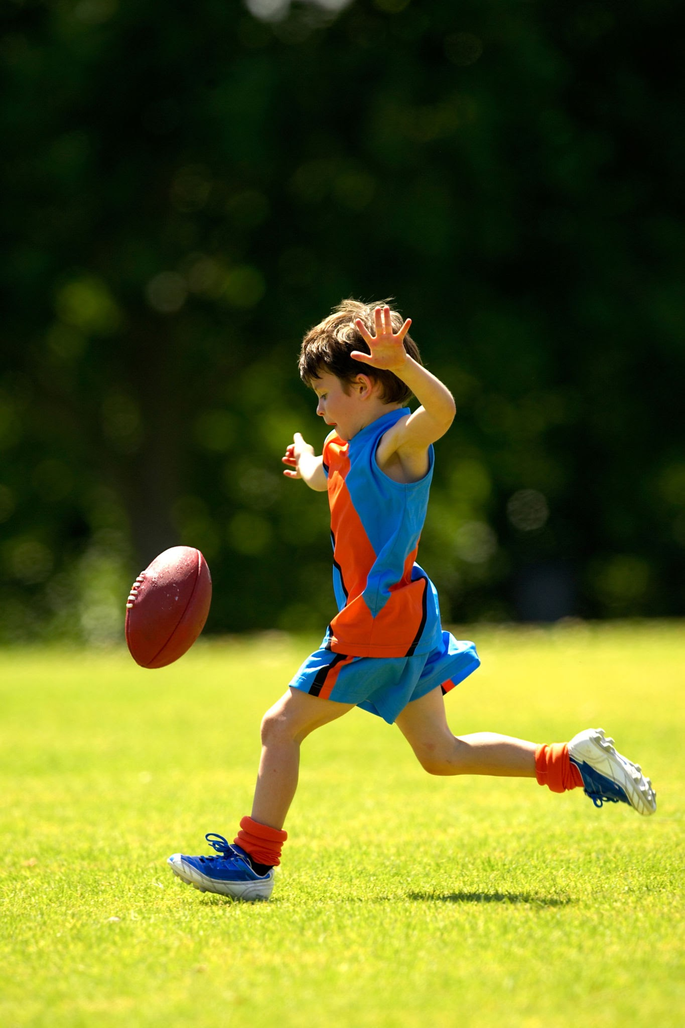
a. Game rules & policies
Detailed AFL SE Region Junior Competition Rules & Policies
A copy of the 2025 rules and policies can be viewed and downloaded from www.aflsoutheast.com.au/rules-and-policies/
‹#›

Slide 19
4. CLUB COMMITTEE
Purpose
Committee & Team Positions
Role Information
‹#›

Slide 20
a. Purpose
Committee Roles and Responsibilities:
The Mordialloc Redbacks Junior Football Club Committee oversees club operations, providing leadership and decision-making while fostering member communication. These roles are volunteer-based.
AGM and Committee Elections:
During the annual August Annual General Meeting (AGM), members can nominate for Committee positions, crucial for our club's smooth operation and a great season experience.
Position Descriptions:
Find detailed role descriptions in this pack.
Join the Redbacks Family:
Be a part of our Redbacks family and enhance the club's legacy. Contact us at www.mordyredbacksjfc.com.au/contact or reach out to Our President, Keeghan Williams on 0403 891 372 for more information.
Your involvement can positively impact young athletes and families.
‹#›

Slide 21
b. Committee Positions 2025
All Committee positions are open for prospective applicants during the club’s annual AGM in August each year. Roles can be shared if needed.
President | Keeghan Williams | Registrar | VACANT
Vice President | Marc Jefferies | Merchandise | Georgia Carey & Lauren Jewell
Club Secretary | VACANT | Auskick Coordinator | Riley Williams
Club Treasurer | Jaclyn Dean | Child Safety Officer / Parent Liaison | Sharon Cann
Director of Coaching | Paul Polgar | Facilities & Grounds | Shaun O’Donnell
General Committee Roles ( Marketing | Events | Sponsorship | Social Media | Website | Club Comms )
Callum Brown, Remeeka Lee, Sorcha Farrell, Josh Scott, Josh Jewell & Brit Hall
‹#›

Slide 22
b. Team Positions 2025
 | U8 | U9 | U10 | U11 | U12 | U14
Coach | Gavin Mahony | Josh Jewell & Luke Cieslack | Josh Scott | Ben Padgham | Callum Brown | Scott McGeachin
Assistant Coach |  |  |  | Matt Di Giovine |  | Glen Cann
Team Manager | Lucy Garland | Georgia Carey | Gavin Bourne | Sharon Cann | Carly Newton | Emma Hill & Nicole Reuben
‹#›

Slide 23
c. Committee Role Information
1. President | 2. Vice President | 3. Club Secretary
Strong club knowledge League operations understanding Leadership experience Budget oversight Public representation Support committee & club strategy Maintain club premises Manage league correspondence Collaborate with local council & community groups | Assist the President in club operations In-depth club knowledge Support league operations and by-laws Contribute to decision-making for club and community improvement Represent the club publicly Back the Committee and future club strategy Assist in maintaining club premises Ready to fill in for the President when needed. | Aid in club operations Support of Club Presidency In-depth club knowledge Support league operations and by-laws Contribute to decision-making for club and community improvement Represent the club publicly Back the Committee and future club strategy Organise Committee meetings and create agendas Document meeting minutes and action items Maintain club records.
‹#›

Slide 24
4. Treasurer | 5. Auskick Coordinator | 6. Events Coordinator
Monitor and report on budgeting Support Committee and financial strategy for the club's future Represent the club publicly | Support Committee and AusKick strategy Run the club's AusKick program Strong club knowledge Support league operations and by-laws Contribute to decision-making for club and community improvement Represent the club publicly | Assist the Committee in club operations Strong club knowledge Support league operations and by-laws Contribute to decision-making for club and community improvement Represent the club publicly Develop and propose social/fundraising programs and grants Organise and conduct social events for club members with support.
‹#›

Slide 25
7. Merchandise Coordinator | 8. Sponsorship Coordinator | 9. Marketing Coordinator
Assist the Committee in club operations Coordinate all club merchandise needs and activities. Strong club knowledge Support league operations and by-laws Contribute to decision-making for club and community improvement Represent the club publicly | Review, develop, and implement an annual sponsorship plan Attract and secure sponsorships Maintain communication with key sponsors to enhance sponsorship value Source vouchers/player recognition awards. Assist the Committee in club operations Support league operations and by-laws Represent the club publicly | Review, develop, and implement an annual marketing and advertising strategy Support the strategy rollout with the Committee and supporting roles (e.g., web and social). Assist the Committee in club operations Support league operations and by-laws Contribute to decision-making for club and community improvement Represent the club publicly
‹#›

Slide 26
10. Website Manager | 11. Social Media Coordinator | 12. Club Communicators/ Voice of Club
Create and maintain the website, including SEO and content management. Support the Committee and website strategy Coordinate sponsor ad display with sponsorship and events managers Assist the Committee in club operations Represent the club publicly | Collaborate with marketing, sponsorship, events, and web managers to plan social media campaigns for community engagement Regularly update club's social media platforms (Facebook & Instagram) Assist the Committee in club operations Support league operations and by-laws Represent the club publicly | Create recurring social/web/Team app communications highlighting club news and updates Collaborate with marketing, sponsorship, events, social, and web managers to coordinate content. Assist the Committee in club operations Support league operations and by-laws Represent the club publicly
‹#›

Slide 27
13. Child Safety Officer/Family Liaison | 14. Director of Coaching
Facilitate communication between families and the Committee as needed Assist the Committee in club operations Support league operations and by-laws Contribute to decision-making for club and community improvement Represent the club publicly | Assist the President in club operations Possess a strong club knowledge Support league operations and by-laws Contribute to decision-making for club and community improvement Represent the club publicly Ensure coaches are aware of digital support resources like https://www.coachassist.com.au/ Current State: Evaluate, assess, and communicate our current coaching and player development capabilities across all teams Future State: Define a vision for talent growth and development, including a strategy to achieve this vision Execution: Implement the strategy through hands-on coaching, regular evaluation, and assessment aligned with the strategy and vision Communication: Maintain regular communication with the Mordialloc Redbacks Junior Football Committee, coaches, and players to track progress in skill development aligned with the strategy and vision.
‹#›

Slide 28
15. Registrar
Ensuring all players are registered in accordance with league guidelines Tracking the number of games played by each player, and notifying coaches of any upcoming milestones Following up with teams to ensure all players are properly registered Coordinating with the Treasurer to follow up any outstanding registration fees Managing player transfers and team lists Communicating registration deadline and process to club members Liassing with club officials, coaches, and committees to support smooth operations.
‹#›

Slide 29
5. GAME DAY
Roles
- Role Information
‹#›

Slide 30
a. Game Day - Roles
Coach | Field Umpire (*when not supplied by the league) | Scorer
Assistant Coach | Goal Umpire | Timekeeper
Team Manager | Boundary Umpire | Ground Marshall
Trainer | Oranges & Lollies | Covid Marshall (*when required)
Runner | Water | Votes
Note:
These tables look scary, but really aren’t ☺ We’ve all been new and learned on the job, so let’s do this together!
Ideally, all game day roles are filled by the same person for the entire season. If that's not possible, the Team Manager will establish a roster to rotate these roles among the team's registered families.
**IMPORTANT - Contact with Umpires:** Only Team Managers are authorised to communicate with Umpires during matches, unless the Umpire(s) initiate contact with other Club Officials. On the field, only the team captain is permitted to approach the Umpire(s).
Every game day role comes with a set of core responsibilities, including:
Supporting the Committee in the club's operations.
Developing a good understanding of the club (or actively working toward it).
Upholding league operations and by-laws (or actively working toward compliance).
Contributing to decision-making for the club's improvement and the betterment of the community.
Representing the club positively in public.
‹#›

Slide 31
Game Day - Role Information
1. Coach
Specific to role Objective To provide the highest standard of coaching and development to the players of the appointed grade of competition Responsibilities They wear a specific Mordialloc Redbacks vest issued by the Team Manager Apply the code of conduct for coaching staff and players that supports the objectives of the club on and off the field Contact all current players as soon as practicable before the start of the season to outline plans for the coming season Develop and establish an appropriate pre-season training program Develop and implement an appropriate ongoing season training program Instruct the players placed under their care generally and to see that all players carry out sufficient training Liaise with other junior grade coaches to establish a consistent coaching policy throughout the club. Provide game day and training coaching expertise Provide clear instruction and feedback to the team and individual players Continually seek to upgrade skills and knowledge of the game Have an understanding of injury prevention, care and management Develop team morale Promote positive club culture and practice code of conduct Participation in upskilling/mentoring/learning opportunities with other club coaches Vote on end of season Best & Fairest Player if requested by the Team Manager (Competitive Age-groups only) To hold or agree to attain level 1 coaching accreditation. To hold or agree to attain level 1 first aid accreditation. To hold or agree to attain a working with children accreditation.
‹#›

Slide 32
2. Assistant Coach
Specific to role They wear a specific Mordialloc Redbacks vest issued by the Team Manager Supporting the coach with role specifics Ability to step in during coach absence Vote on end of season Best & Fairest Player if requested by the Team Manager (Competitive Age-groups only)
‹#›

Slide 33
3. Team Manager
Specific to role They wear a specific Mordialloc Redbacks vest issued by the Team Manager The Team Managers role is to: ensure the efficient & smooth running of the team provide support to the coach & other club officials act as a liaison between parents & the coach &/or club officials work together with club officials, coaches & parents to ensure that the Rules of the League, Codes of Behaviour, and Club Policies are being adhered to & properly observed at all times The Team Managers responsibilities as per Match Day Rules: ensure that players are in the correct uniform on game days, including wearing mouth guards ensure that player jumper numbers on team sheets are correct before being handed to the umpire and opposition team manager ensure that players ticked off on team sheet are actually at the game ready to play (please note any club who ticks a player off as playing who was not at the game will face penalties for breach of playing rules) for teams playing in premiership ages ensure the umpire hands the home team 2 x signed umpire team sheets (1 from each club), the umpire vote card sealed in envelope and 3 x scorecards at the completion of the game, to be returned to MRJFC for teams playing U8 to U10 ensure that the home team receives 2 x umpire team sheets (1 for each club) to be returned to MRJFC Continued…
‹#›

Slide 34
3. Team Manager (continued)
Rules: It is essential that the Team Manager is familiar with the Rules of the League, Codes of Conduct & Club policies. Player medical treatment plan (provided by the family if a player has a known medical condition) must be available at all matches and training sessions & the Team Manager should be aware of any alerts or immediate treatment requirements specified on those forms. Match Day: Complete weekly Team Sheet Provide Field Umpire with umpire fee and team sheet & ensure all team sheets are signed Provide goal umpire with pen, scorecard, white coat & flags U11 upwards: Ensure goal umpire knows to meet other goal umpire at the end of each quarter to agree score and ensure score board correct plus same team manager kept score Provide Boundary Umpire with plain white shirt & whistle Team Runner must be clearly identified with an orange or bright green shirt provided by the club. The runner must only be on the field to deliver 3 messages then return to the coaches’ box The Team Manager and match day officials are the only people able to speak with the umpires Water is to be provided to the umpires during quarter & half time breaks by the home team’s Team Manager or home team match day official Coach must complete a Field Umpire’s report when requested by the League Continued…
‹#›

Slide 35
3. Team Manager (continued)
Home matches: Timekeeper & scoreboard attendant are to be arranged by the home team Umpires voting cards are to be given to the central umpire in addition to the team sheet before the game and received back at the conclusion of the game from umpires for the home club to submit to the League. After every match: Completed team sheets/scorecards/best players/goal kickers & umpires votes (if a home game) are to be dealt with as per your clubs policy. Scores need to be in by 7pm on the Sunday Vote on end of season Best & Fairest Player if requested by the Team Manager (Competitive Age-groups only)
‹#›

Slide 36
4. Trainer | 5. Runner
Specific to role They wear a specific Mordialloc Redbacks vest issued by the Team Manager One Trainer is located near the Coach and Interchange Area. If there’s a second Trainer, they are on the opposite side of the field near the pavilion Level 1 First Aid Accreditation minimum, Emergency Response Coordinator recommended The Trainer’s duty is to attend to injured players and then immediately leave the ground Trainers are not to carry messages from the coach and are not to speak to the umpire(s) or opposition players Vote on end of season Best & Fairest Player if requested by the Team Manager (Competitive Age-groups only) | Specific to role They wear a specific Mordialloc Redbacks vest issued by the Team Manager There is normally one Runner per team Sole duty is to deliver the coach’s message and then take the most direct route back to the coach immediately after delivering the message Only two messages can be delivered during any one trip onto the field (any more than this is construed as coaching, and is illegal) Vote on end of season Best & Fairest Player if requested by the Team Manager (Competitive Age-groups only)
‹#›

Slide 37
6. Field Umpire
Objective The role of the umpire is to apply the laws of the game and ensure the game is played in a safe and fair manner. The laws of the game give the umpire the responsibility to manage the game both on and off the ground. Responsibilities Field umpires are in control of the whole running of the game and make decisions regarding all contests. Ensuring all match paperwork is completed correctly Ensuring teams follow all AFL laws and by-laws Ensuring the match is conducted in the spirit of the game and according to all relevant laws Ensuring a safe environment for all players Umpiring the game during general play Assisting the other umpires (Boundary Umpires and Goal Umpires) in their jobs where applicable and necessary Making fair, unbiased and consistent decisions The field umpire must be fit and have an excellent understanding of the laws of the game. They must be able to work as part of a team, be fair, consistent and calm under pressure Field Umpires supplied by the League must be in official League-provided uniform. Field Umpires supplied by MRJFC must wear a specific Mordialloc Redbacks vest issued by the Team Manager
‹#›

Slide 38
7. Goal Umpire
Specific to role They wear a specific Mordialloc Redbacks vest issued by the Team Manager One Goal Umpire is provided by each team Goal Umpires stand between the large goal posts, behind the boundary line, and are to wear a white coat (supplied by the club) If a goal is scored, two flags (supplied by the club) are waved If a point is scored, one flag is waved The goal umpire at the opposite end of the field to which a score is made mirrors the flag-waving of the scoring end Each goal umpire records on their scorecards (supplied by the club) all scores made at both ends of the field A goal scores six (6) points, a behind or point scores one (1) point
‹#›

Slide 39
8. Boundary Umpire
Specific to role They wear a specific Mordialloc Redbacks vest issued by the Team Manager They must carry a whistle One Boundary Umpire is provided by each team For set shots at goal, stand alongside the behind post to watch the flight of the ball When the ball goes out of play signal to the Field Umpire based on whether the ball is Out of Bounds or Out of Bounds on the Full "Out of Bounds”: where the football passes completely over the Boundary Line or touches a behind post or touches the padding or any other attachment to the behind post but before doing so, touches the ground or is touched by a Player on or above the knee. If any portion of the football is on or above the Boundary Line, the football is not Out of Bounds. To signal out of bounds, blow the whistle and extending one arm in the air. “Out of Bounds On the Full”: means the football, having been Kicked, passes completely over the Boundary Line without touching the ground within the Playing Surface or being touched by a Player on or above the knee, or the football has touched the behind post or passed over the behind post without touching the ground or being touched by a Player on or above the knee. To signal out of bounds on the full, blow the whistle and extending both arms at shoulder height. Show the players the mark (where the ball crossed the line). When directed by the Field Umpire they must then throw the ball back into play
‹#›

Slide 40
9. Timekeeper | 10. Scorer
Specific to role Each team must supply a Timekeeper Both Timekeepers are to complete all details on the timekeeping card, including the scores, and sign the timekeeper’s card on completion of the game The Field Umpire can instruct the Time Keepers to add time; this includes when the match is held up to remove an injured player from the field or for any other abnormal time lost. Any time added for a quarter will be for that quarter only; the remaining quarters will be of the prescribed length for the competition. The Timekeepers shall sound the siren to signal the end of a quarter until a field Umpire acknowledges that the siren has been heard and brings play to an end Where the Umpire has mistakenly heard the siren to sound the end of playing time or the siren sounds mistakenly prior to the end of a quarter the Timekeepers must alert the Field Umpire as soon as possible of the error Vote on end of season Best & Fairest Player if requested by the Team Manager (Competitive Age-groups only) | Specific to role The Home Team is responsible for providing a Scoreboard and someone to keep the score displayed accurate Formally, the Time Keeper is responsible for keeping the scoreboard accurate and up to date, however, at Mordialloc Redbacks JFC, another parent (or responsible younger person) is typically needed as the scoreboard and Time Keeper are usually some distance and/or flights of stairs from each other Vote on end of season Best & Fairest Player if requested by the Team Manager (Competitive Age-groups only)
‹#›

Slide 41
11. Ground Marshall | 12. Water Carrier
Specific to role They wear a specific Mordialloc Redbacks vest issued by the Team Manager The Home Team is responsible for providing a Ground Marshall at each home ground match The Ground Marshall must be an adult The Ground Marshall is required to escort the Field Umpire(s) from the field at half time and after the match The Ground Marshall will stand with the Field Umpire(s) during the quarter and three quarter time breaks Ground Marshall will be responsible for monitoring crowd behaviour and bringing any inappropriate conduct to the attention of club officials The Ground Marshall will also be the point of contact for any queries or concerns about the venue Must wear the League approved identification The Ground Marshall must be a responsible adult and should not hold any other match day official role (e.g. the Ground Manager should not be the Team Manager or the Canteen Manager) Vote on end of season Best & Fairest Player if requested by the Team Manager (Competitive Age-groups only) | Specific to role They wear a specific Mordialloc Redbacks vest issued by the Team Manager Water Carriers are not permitted to enter the coach’s box at any time during play At no time are Water Carriers to deliver messages to players Water Carriers be of a suitable age for the particular age group If not delivering water, Water Carriers must stay off the playing surface and behind the boundary line to enable the Boundary Umpire to carry out their duties After delivering water, Water Carriers must leave the field of play by the most direct route and remain behind the boundary line, out of the path of the Boundary Umpire Vote on end of season Best & Fairest Player if requested by the Team Manager (Competitive Age-groups only)
‹#›

Slide 42
13. Covid Marshall
Specific to role They wear a specific Mordialloc Redbacks vest issued by the Team Manager Each team must nominate at least one COVID Marshall and as a minimum this person must undertake the free Australian Government online COVID-19 Infection Control Training prior to recommencement of Club activity Teams are encouraged to have multiple people take ownership of this role and share the responsibility Duties for the COVID Marshall include: Get team sheet from Team Manager on arrival Check in the kids ask them if they are well and tick them off the team sheet kids are not required to sign the team sheet this season Make additional notes on the team sheet if you need to send any players home After checking all the kids in hand the team sheet back to the team manager Sanitise change room benches Sanitise bench and ball during breaks Vote on end of season Best & Fairest Player if requested by the Team Manager (Competitive Age-groups only)
‹#›

Slide 43
14. Oranges & Lollies
Specific to role This role is often rostered with a different family providing snacks each week The family rostered to oranges and/or lollies duties for that game day provides cut oranges and lollies (eg snakes) for the players at half time. This can be given to the Team Manager in the pre-match warm up.
‹#›

Slide 44
6. CONTACT US
Our Location
Socials
Web
Phone/Email
‹#›

Slide 45
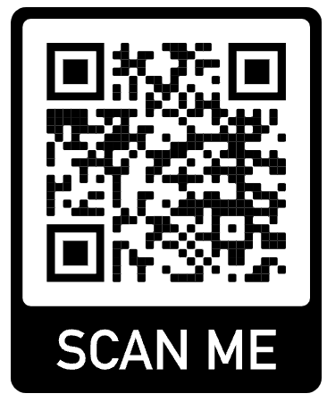
Our location
Ben Kavanagh Reserve, Mordialloc, Victoria 3195 (corner of Chute Street and McDonald Street).
Socials
MordyRedbacksJFC
#RedbacksLeadingStrong
Web
www.mordyredbacksjfc.com.au/contact
Phone / Email
President – Keeghan Williams 0403 891 372 mordyredbacks@gmail.com
Secretary – VACANT

Slide 46
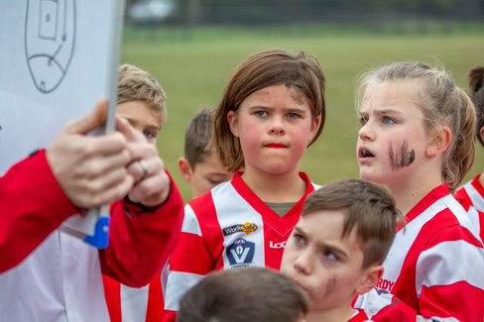
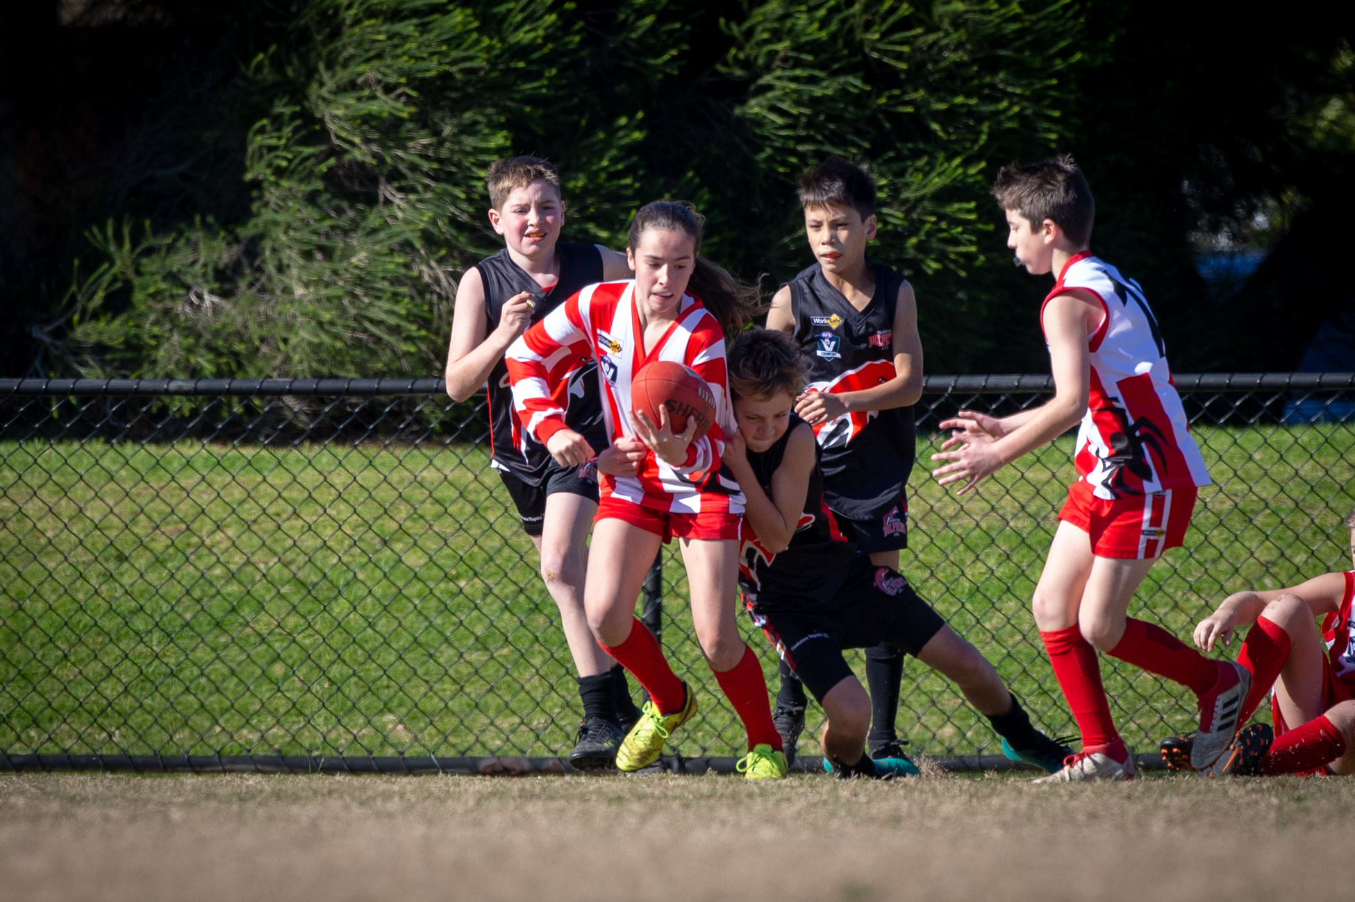
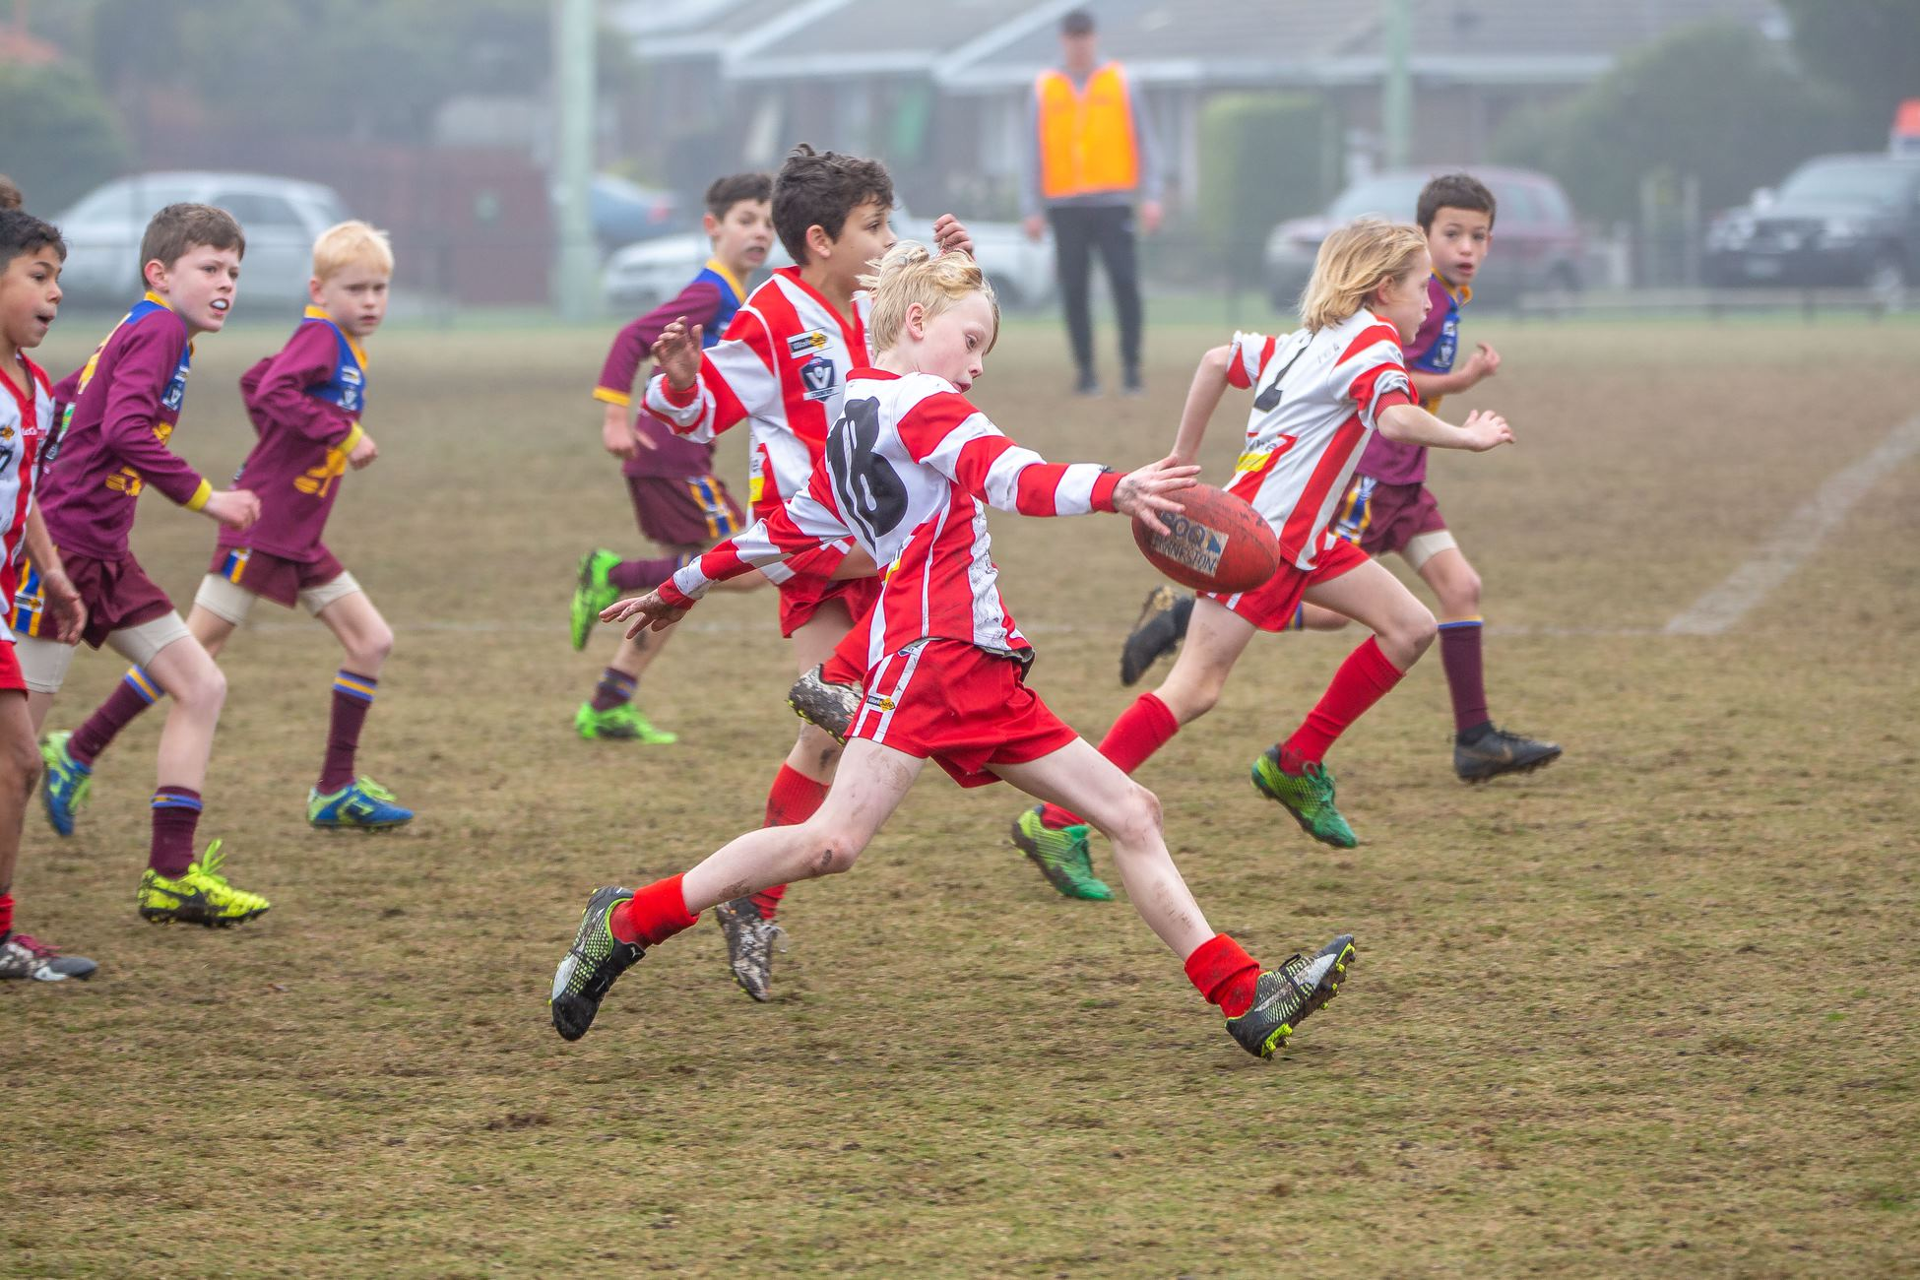
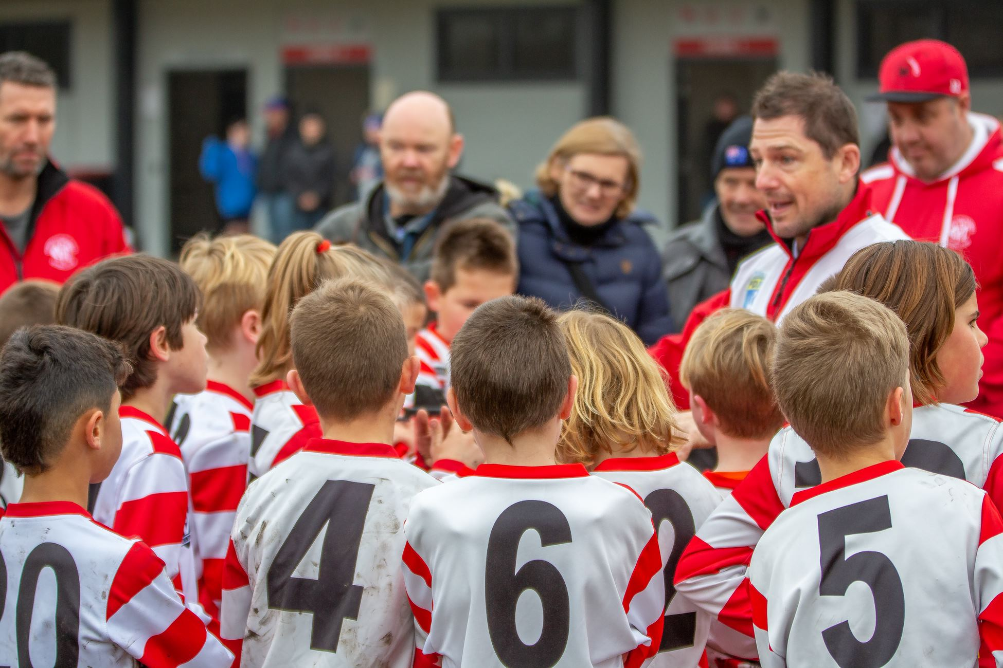
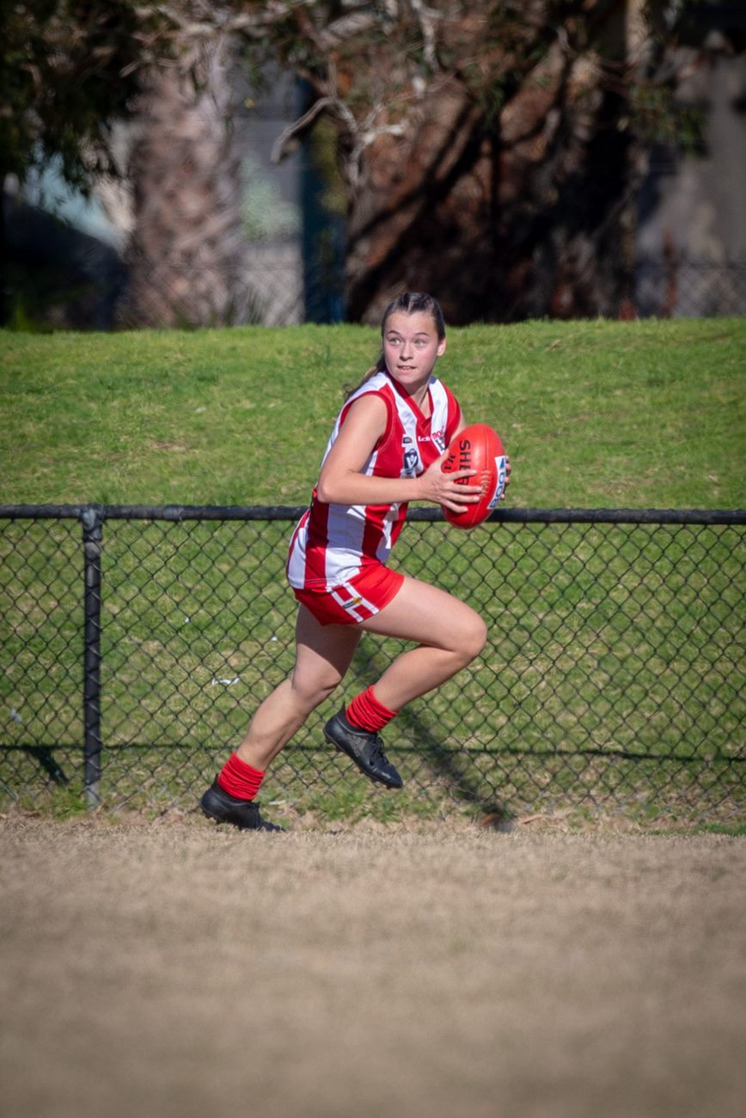
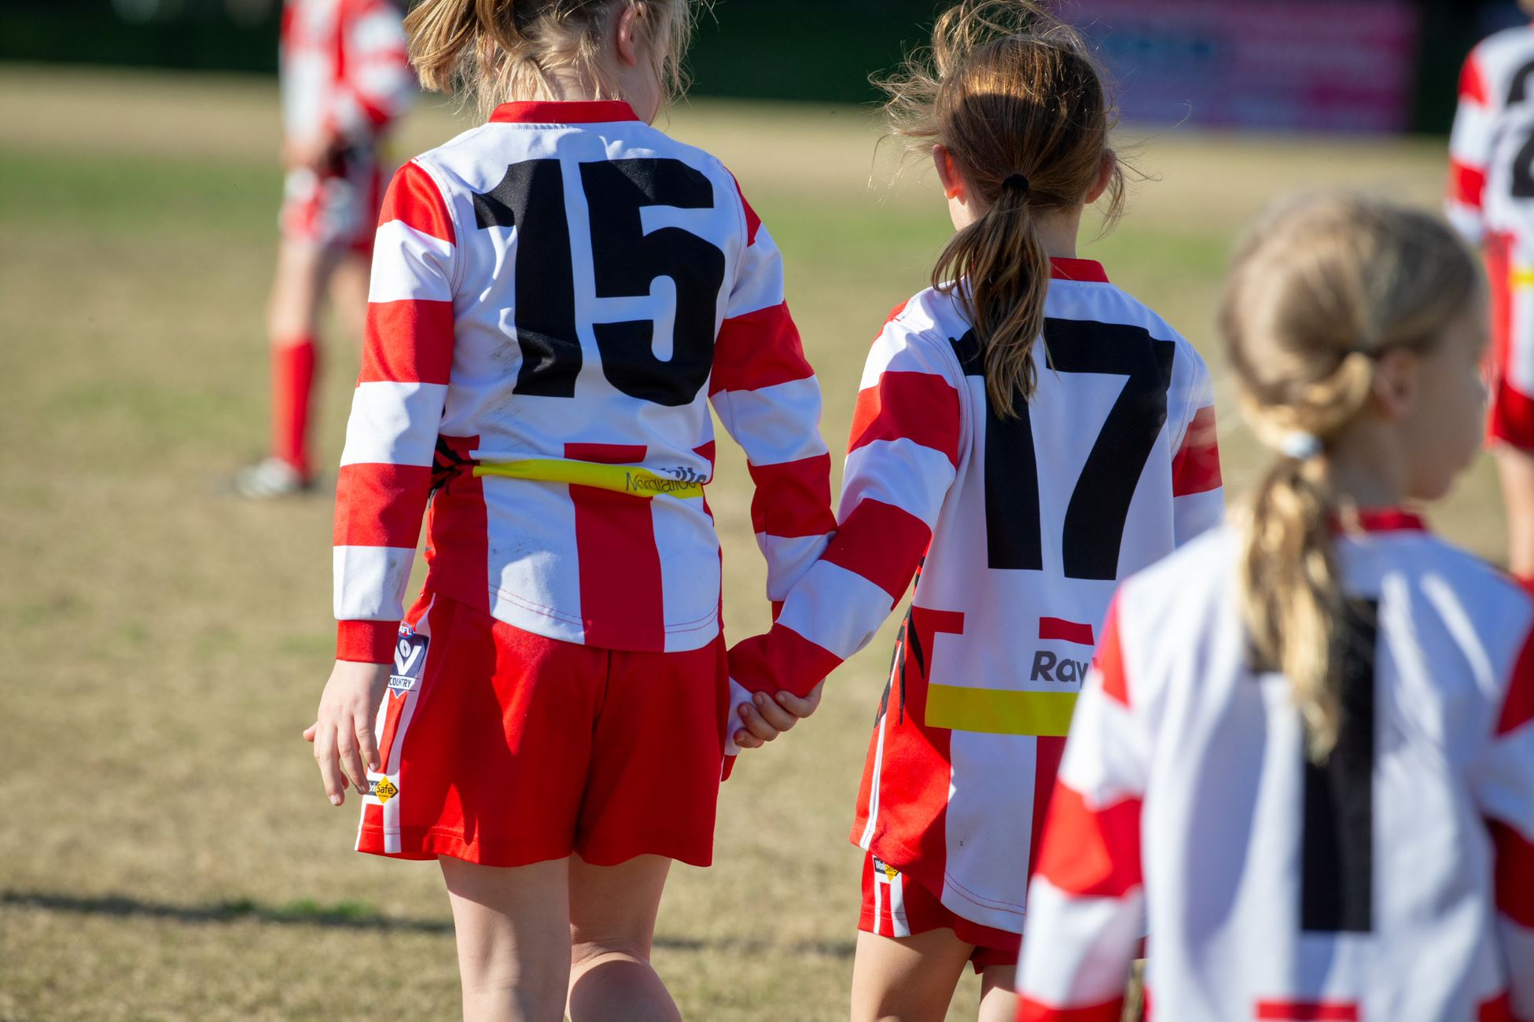
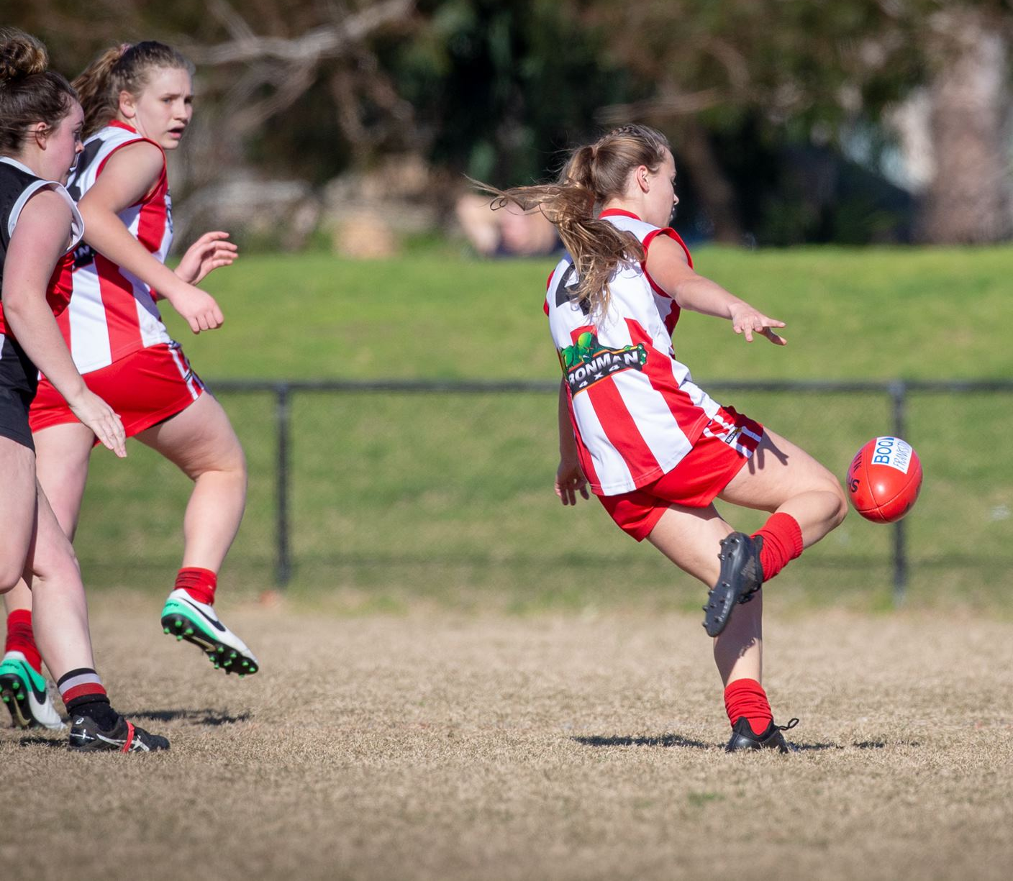
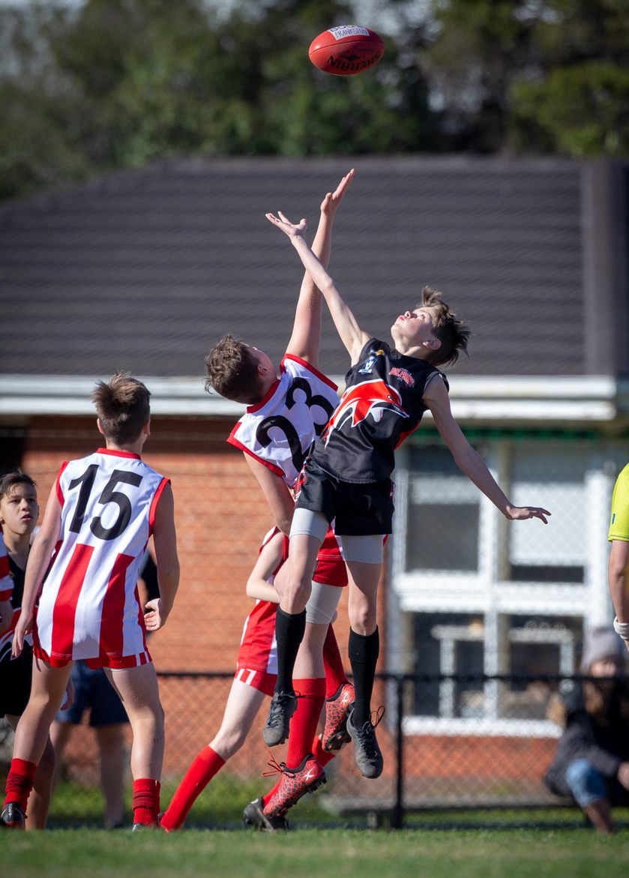
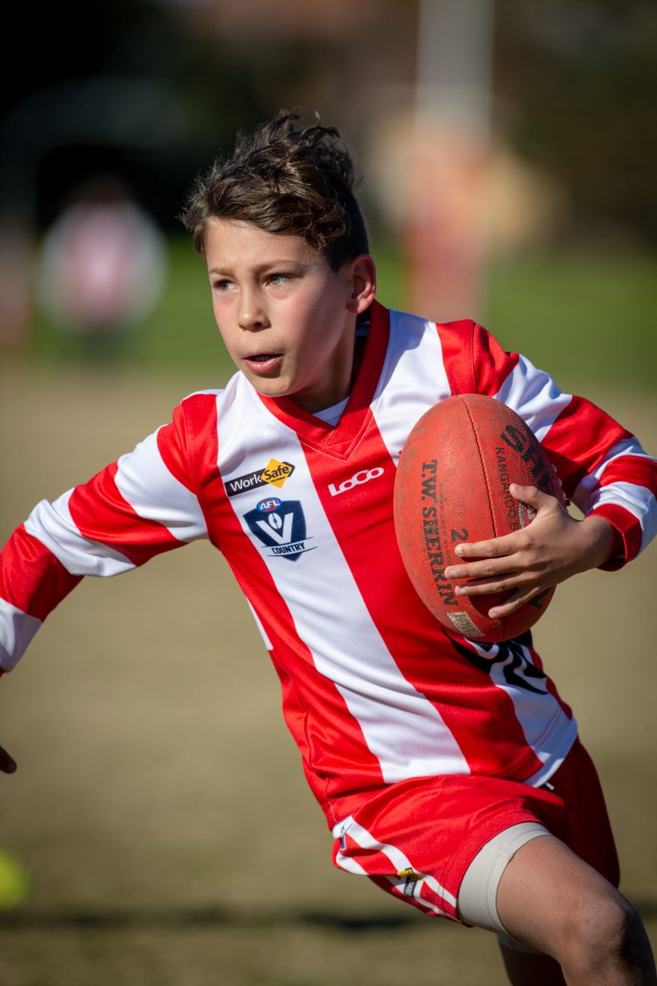
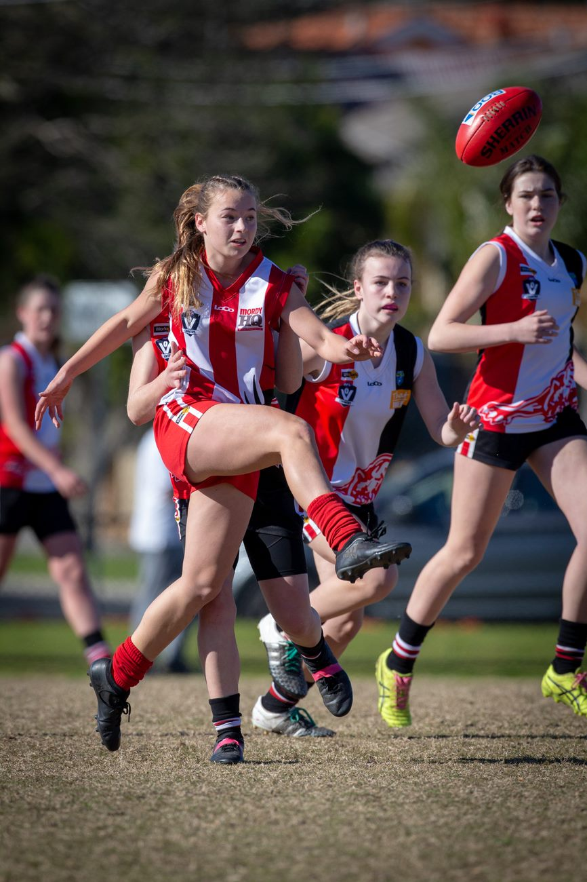
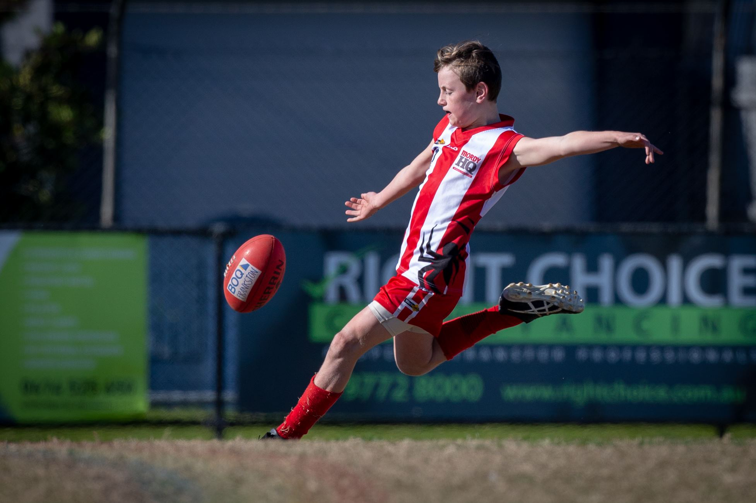
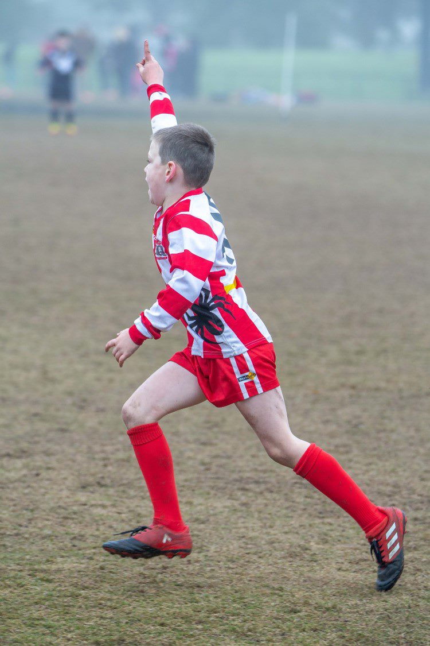

Slide 47
THANK YOU
Author: Mordialloc Redbacks Junior Football Club Committee 2025
For edits, please contact https://www.mordyredbacksjfc.com.au/contact
‹#›

